Slide 1


Provident Fund

Slide 2
PF compliance forms submission
At the time of joining the organization, employees have to mandatorily submit the Hard copy of below statutory compliance PF forms in the organization:
Declaration Form
Form F: Gratuity Nomination form
Form 2: PF Nomination Form
Form 11 (revised)

Slide 3
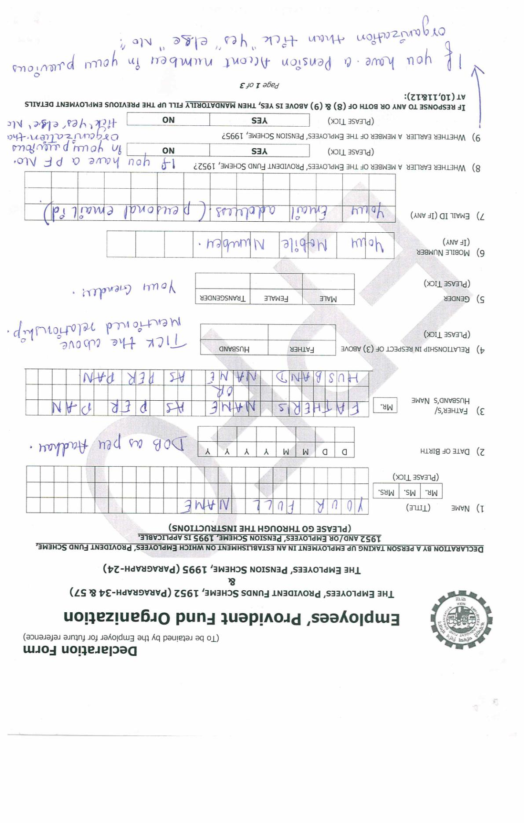
Declaration Forms “Important Point”
Point 1-7 - Mention your personal details
Point 8 - If earlier you were the member of EPF scheme than mention “Yes” else mention “No”
Point 9 - If earlier you were contributing towards EPS (Employee Pension Scheme) than mention “Yes” else mention “No”

Slide 4
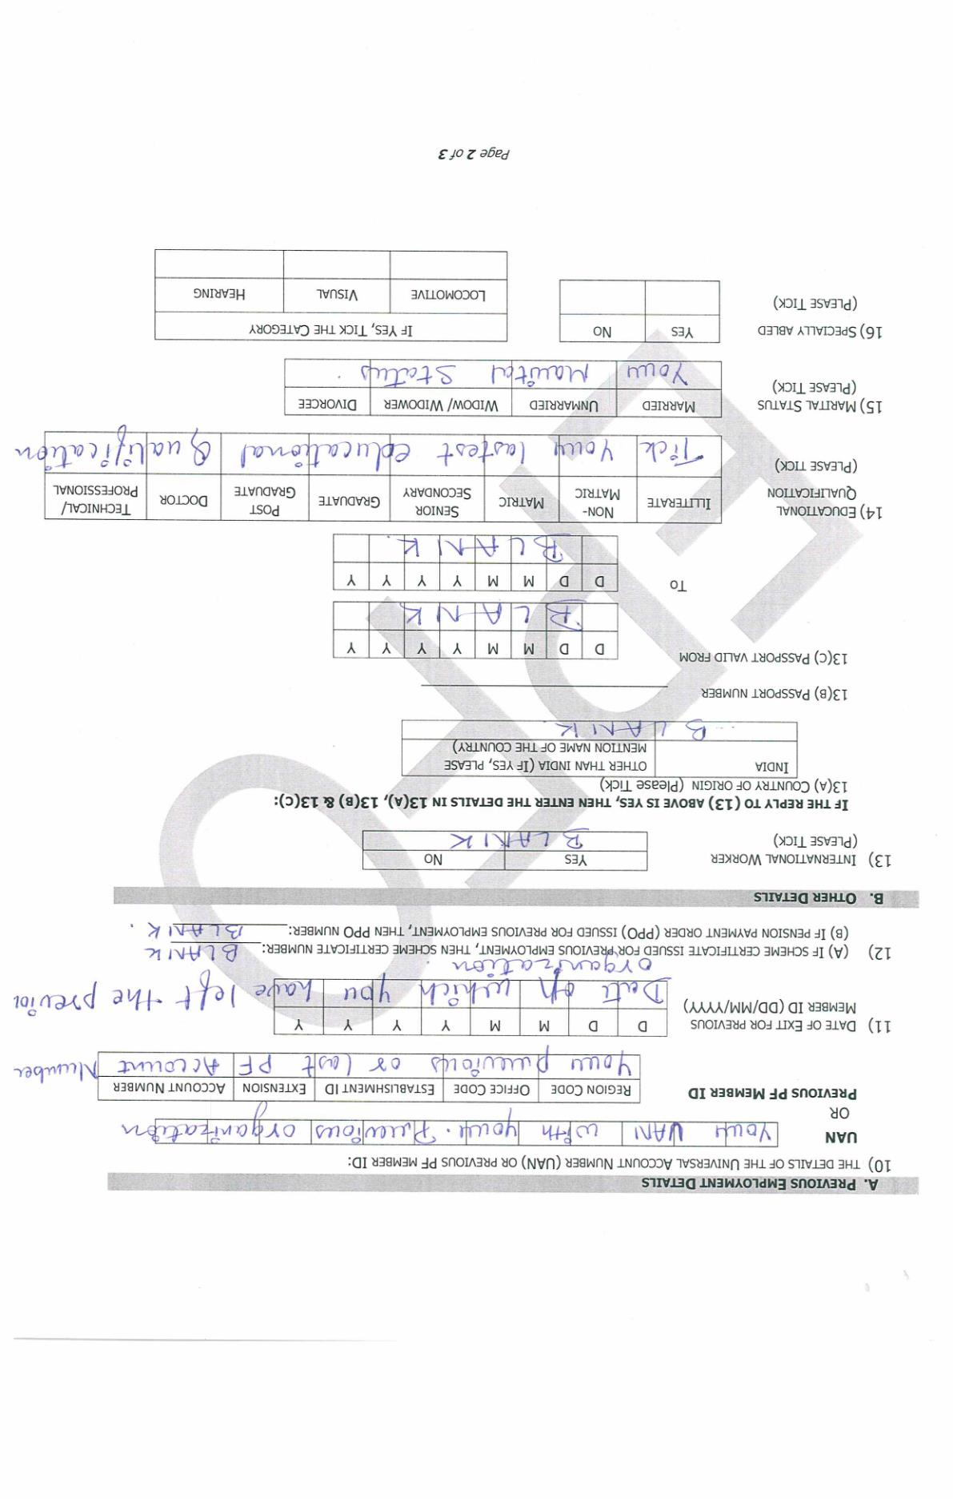
Important Point
Point 10 - You can mention either your UAN or PF number
Point 11 – Mention Date of Exit from your Last Employer where you had a PF account number
Point 12, 13 – Blank
Point 14- Tick your latest educational Qualification
Point 15 – Tick your Marital Status

Slide 5
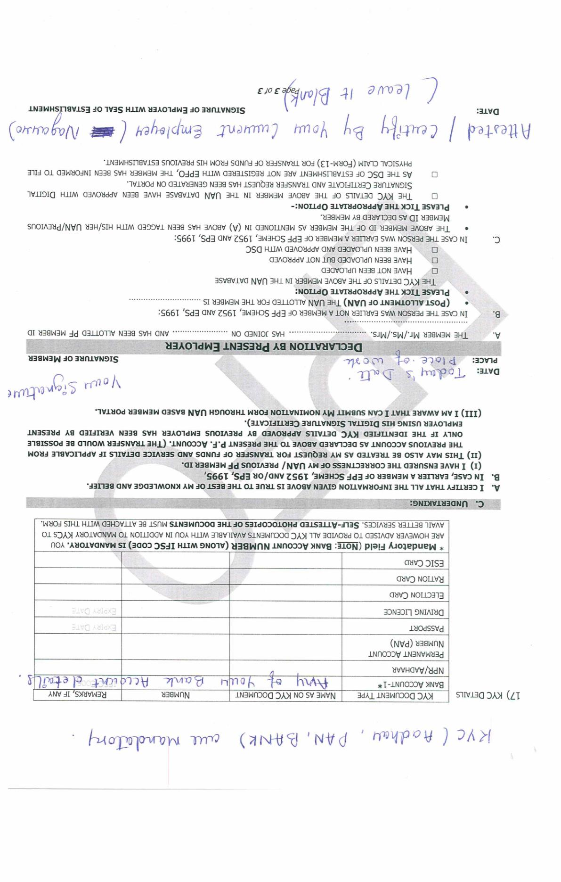
KYC Details
In Point 17 - You have to mandatorily provide your three KYC details mentioned below:
Aadhar
PAN
Bank
2. Sign the undertaking
3. Declaration by present employer - Blank

Slide 6
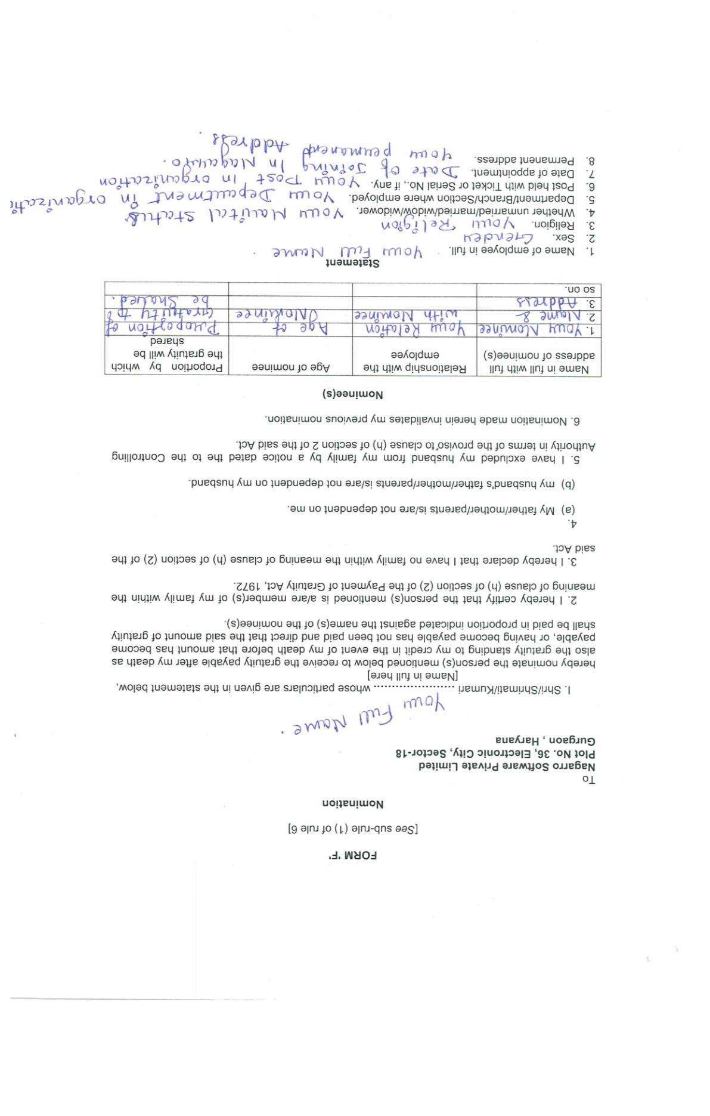
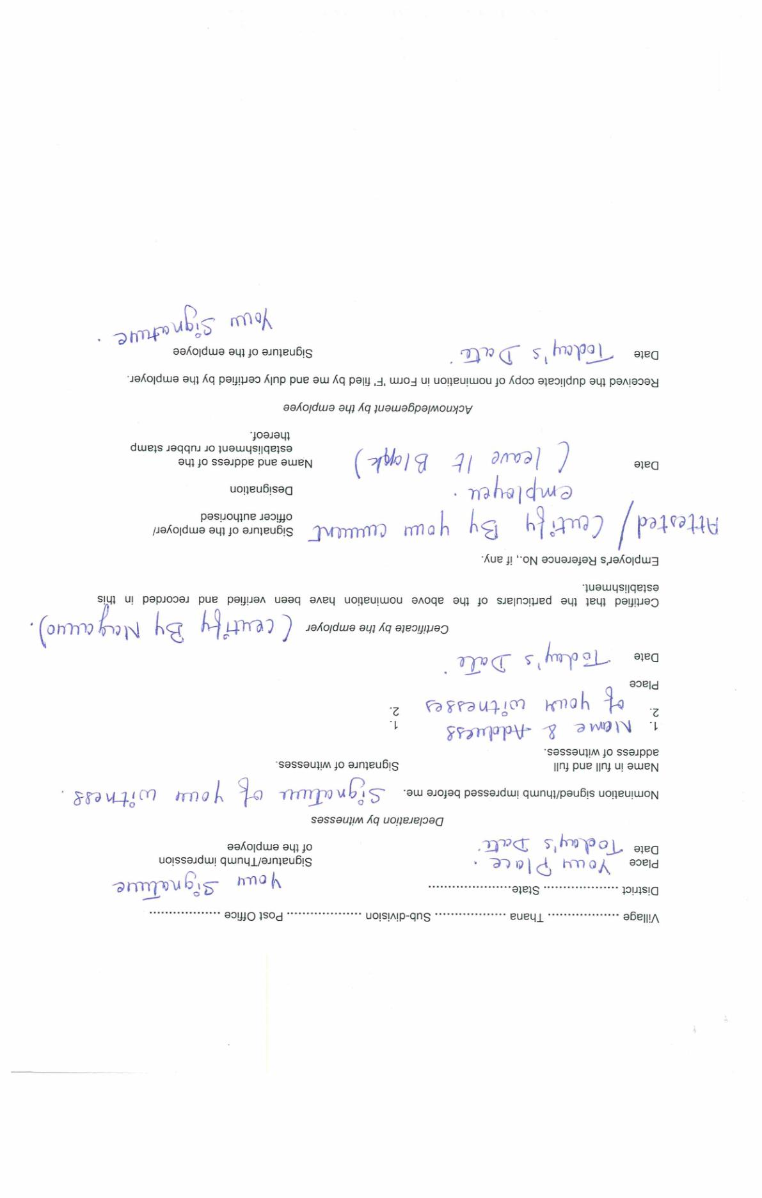
Form F

Slide 7
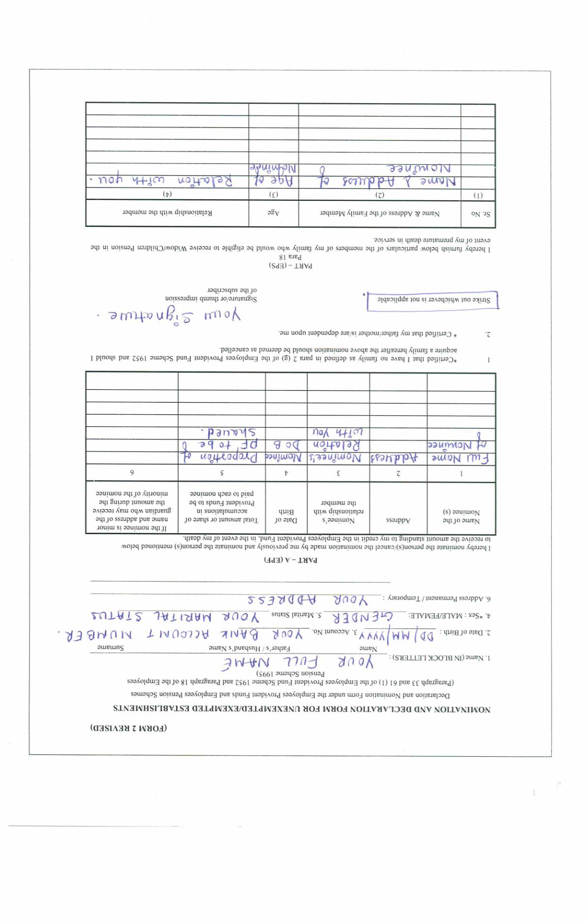
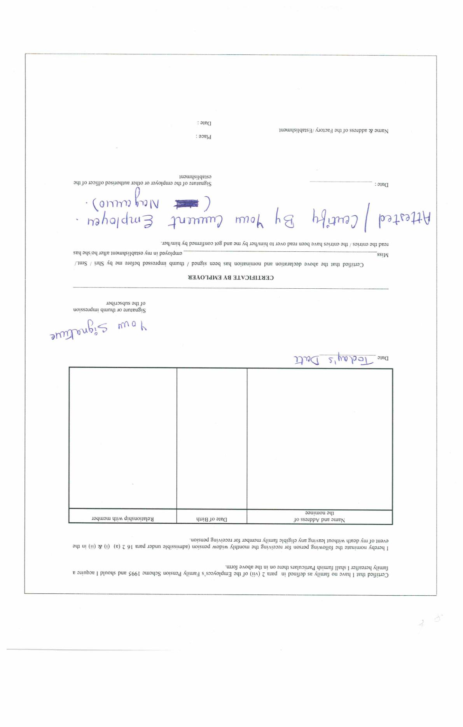
Form 2 (Revised)

Slide 8
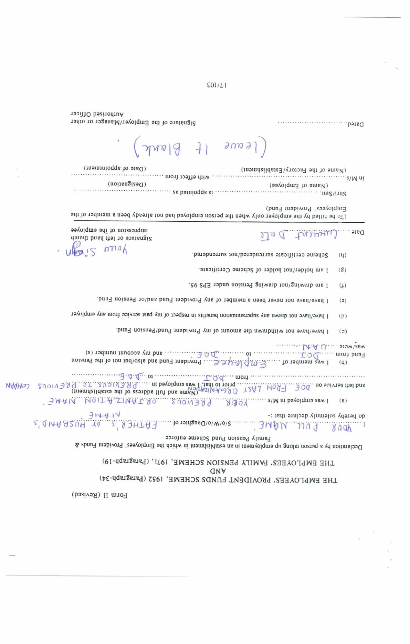
Form 11

